Slide 1
Project Title: H1B Visa Petition Analysis
Introduction to Data Science (MATH 3900 / CS 5963), University of Utah
Ashutosh Sharma: U1158306 Pratik Laxman Sawant: U1166421 Adesh Valecha: U1193441

Slide 2
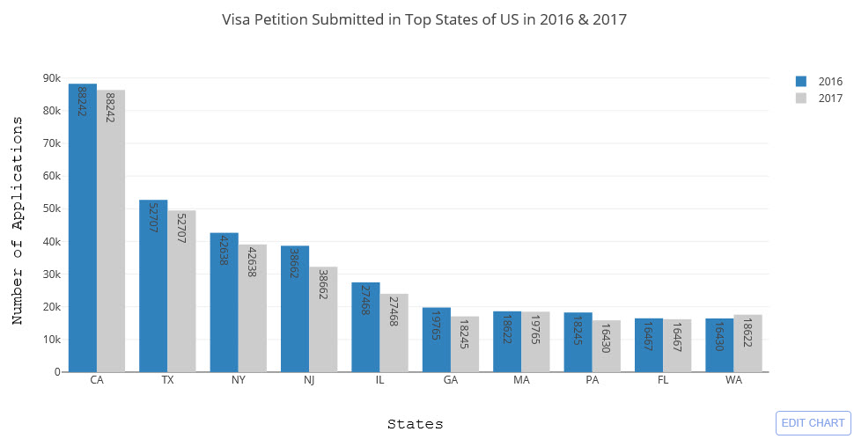
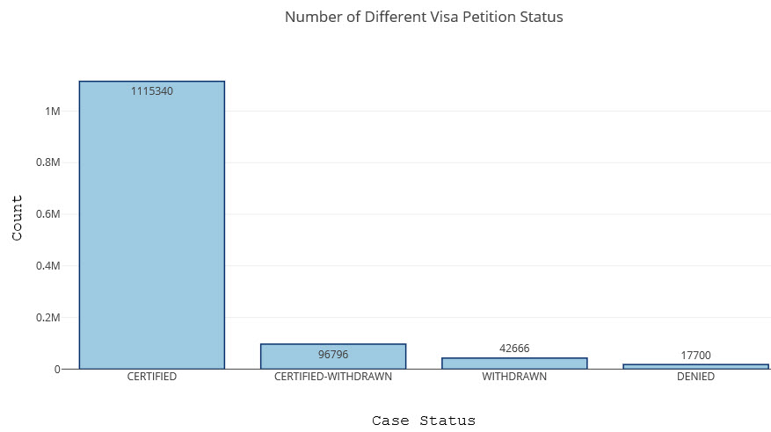
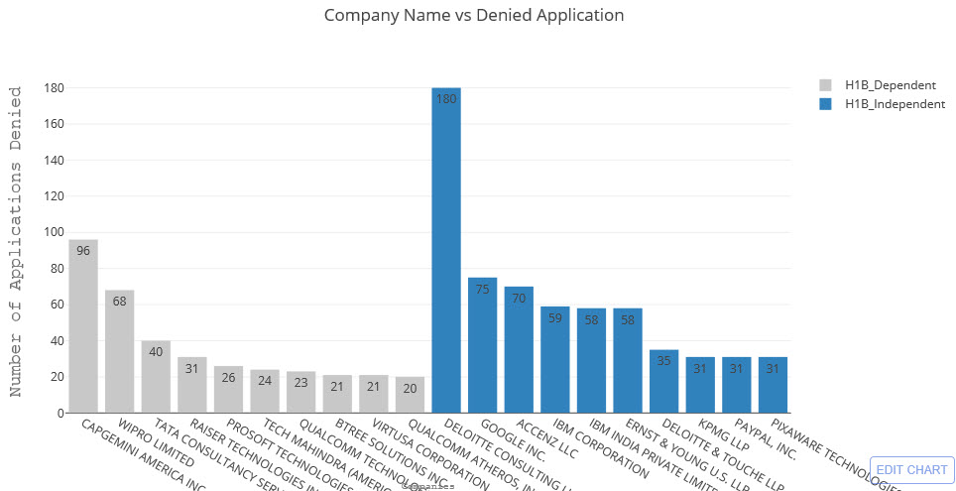

Slide 3
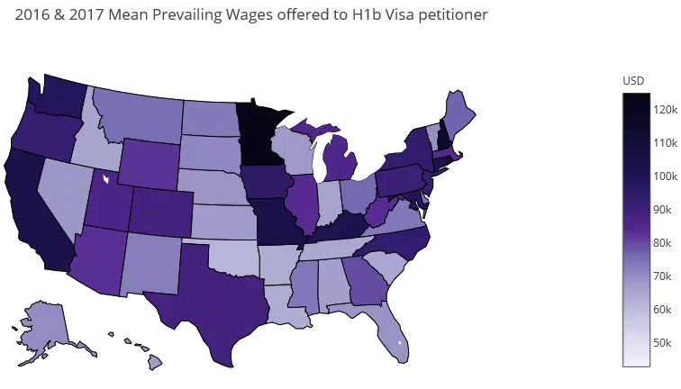

Slide 4
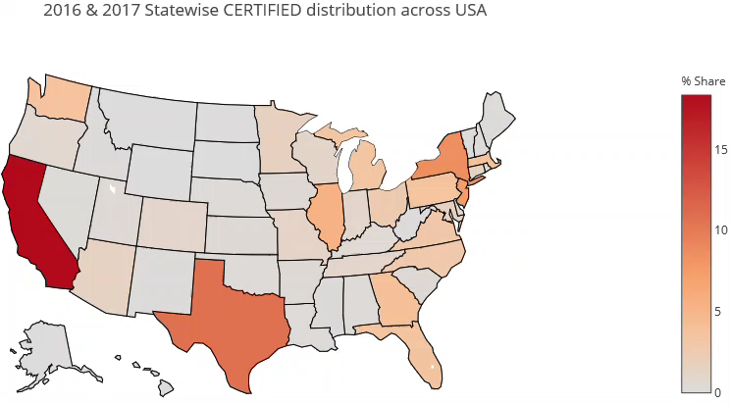

Slide 5
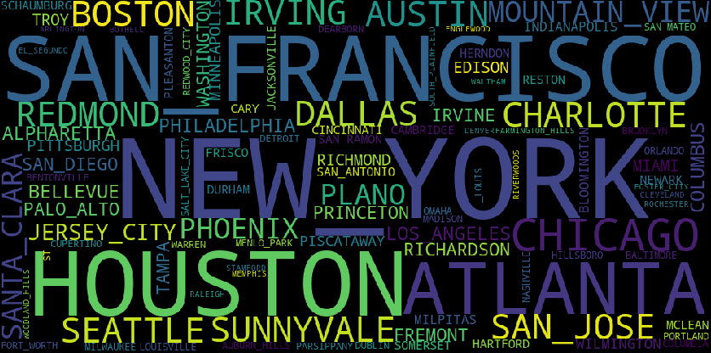

Slide 6
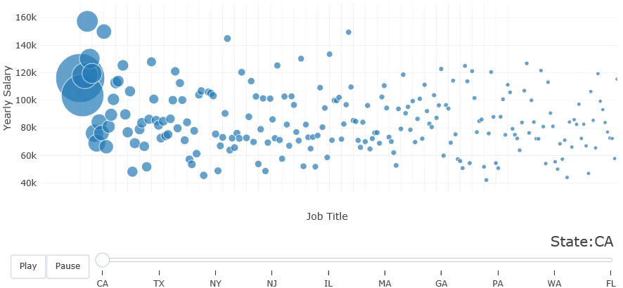

Slide 7
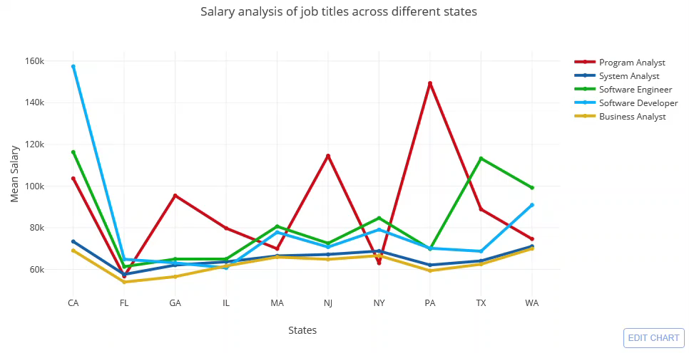

Slide 8
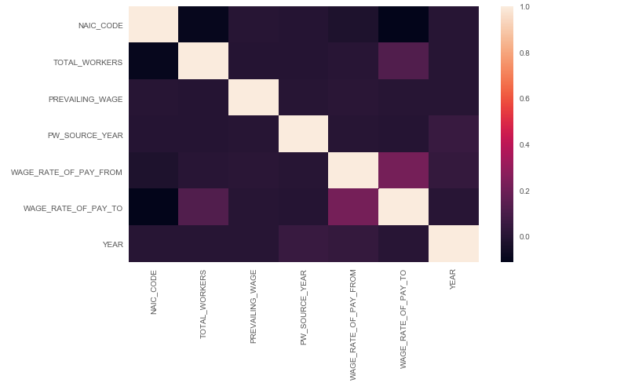
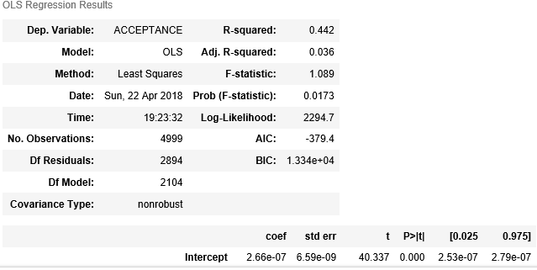
Correlation of Variables and Regression model Summary

Slide 9
Recommendations
If a person had to choose to apply for H1b visa the best bet would be California(San Francisco) or Texas(Houston) for a Programmer Analyst/ Systems Analyst position that would pay be an average salary of 100k+ if negotiated properly and have high chances of getting a CERTIFIED H1B visa petition.

